Slide 1

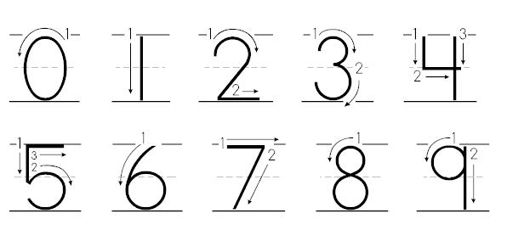
Kindergarten Family Newsletter
Mission: Elk Meadows Falcons are growing to be resilient, lifelong learners.
Date: September 2, 2025
Grade-Level Events
September 23rd: Picture Day
September 26th: No School (Professional Development)
October 1-2: Parent Teacher Conferences
October 3: No School (PTC Comp Day)
October 9: Field Trip to Hogle Zoo
Math
Focus: I can write and recognize numbers 1-10 out of order.
Example: Sometimes have your child write the numbers in order, other times tell them a number out of order and have them write it.
Language Arts
Focus: I can say the letter name and sound for all letters in the alphabet (both uppercase and lowercase). *See Planet Kindergarten Goal
Example: You can help your child practice different ways. Variation is important.
*Say a letter name or sound and have your child write it. (chalk, white board, markers)
*Make flashcards with letters. Lay them on the floor. Say a name/sound and have your child find it. They can tap it, jump on it, or place a small toy on it.
**Read with your child every day!
Science
Focus: Trees-We are learning about trees and their parts. How animals and people use them and how they affect the environment.
Example: Go for a walk and look at how the tree is changing with the season. Look for how animals are using the tree and how the trees interact with their environment.
Social Studies
Focus: I can show good ways to behave at home and in my classroom.
Example: Talk about our class rules. Have your child give examples of following the rules and examples of not following the rules.
Class Rules
We follow adult directions the first time.
We keep our bodies, objects, and hurtful words to ourselves.
We respect adults, peers, and property.
We are prepared.
We are where we are suppose to be.
Family Connection/Additional Information
We are focusing a lot on letter and number formation. It is important for students to follow the correct “path of motion”. Please see above for the correct “path of motion” when writing numbers. The correct “path of motion” for letters is on the back of this newsletter. You can also help your child hold their pencil correctly.

