Slide 1
K-3 Teachers
4-6 & Support Teachers
Other
Classes, & Student Support
Office
Click on each door to learn more about Elk Meadows!

Slide 2
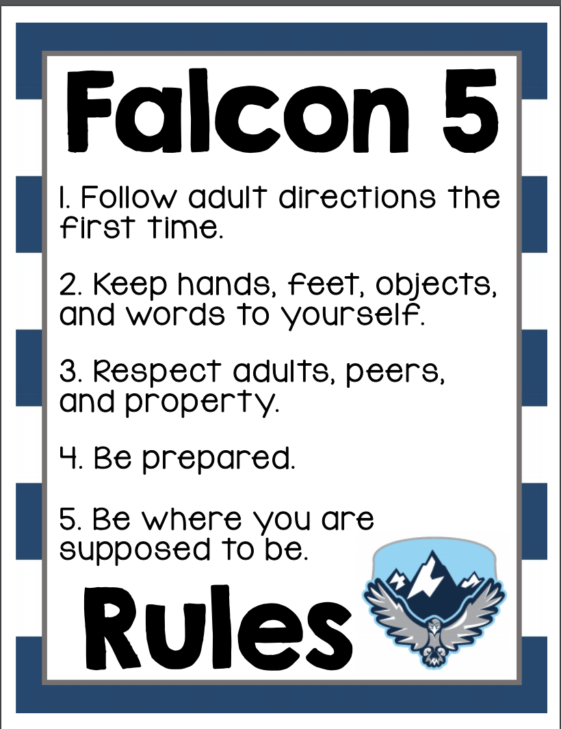
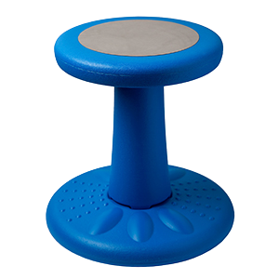
Click the grade level below to learn more!
K
1
2
3
Back

Slide 3
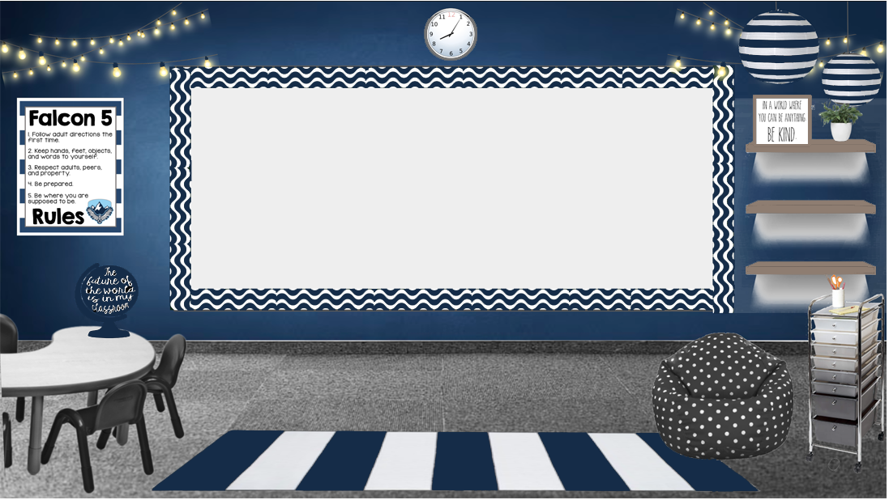
4
5
6
Special Education
Back

Slide 4
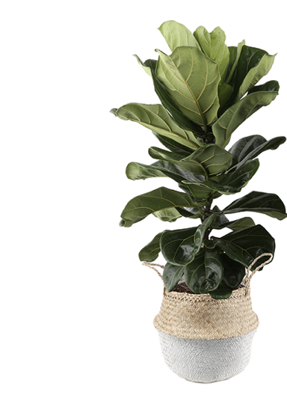
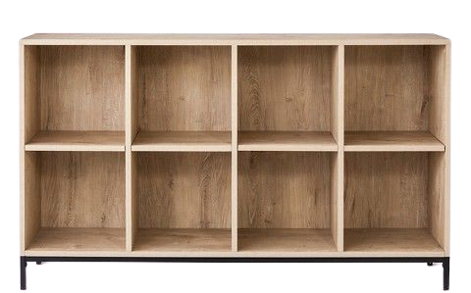
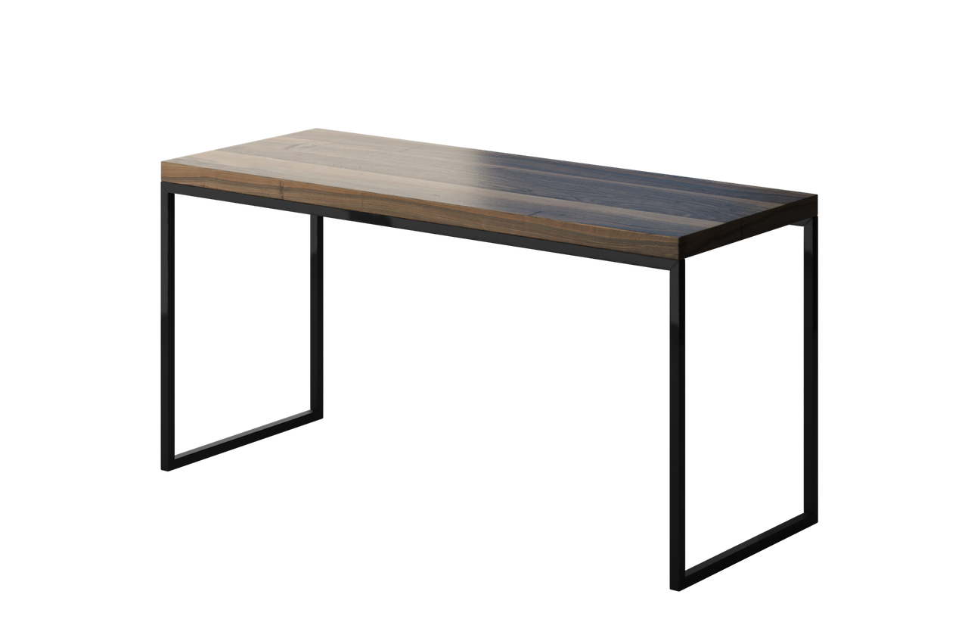
Click in each box above to learn more!
Back

Slide 5
Back

Slide 6
Back

Slide 7
Back

Slide 8
Back

Slide 9
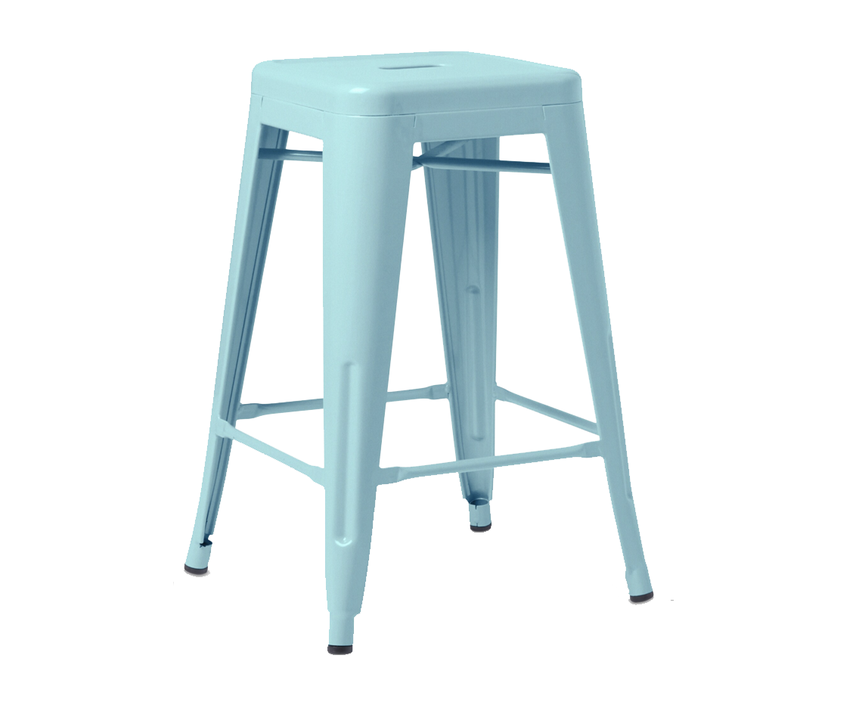
Click the items below to
learn more
Speech
Back

Slide 10
Orchestra Flyer
Back

Slide 11
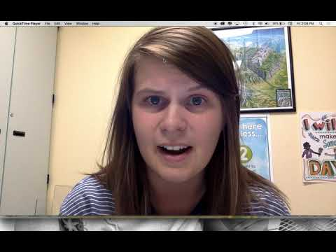
Back

Slide 12
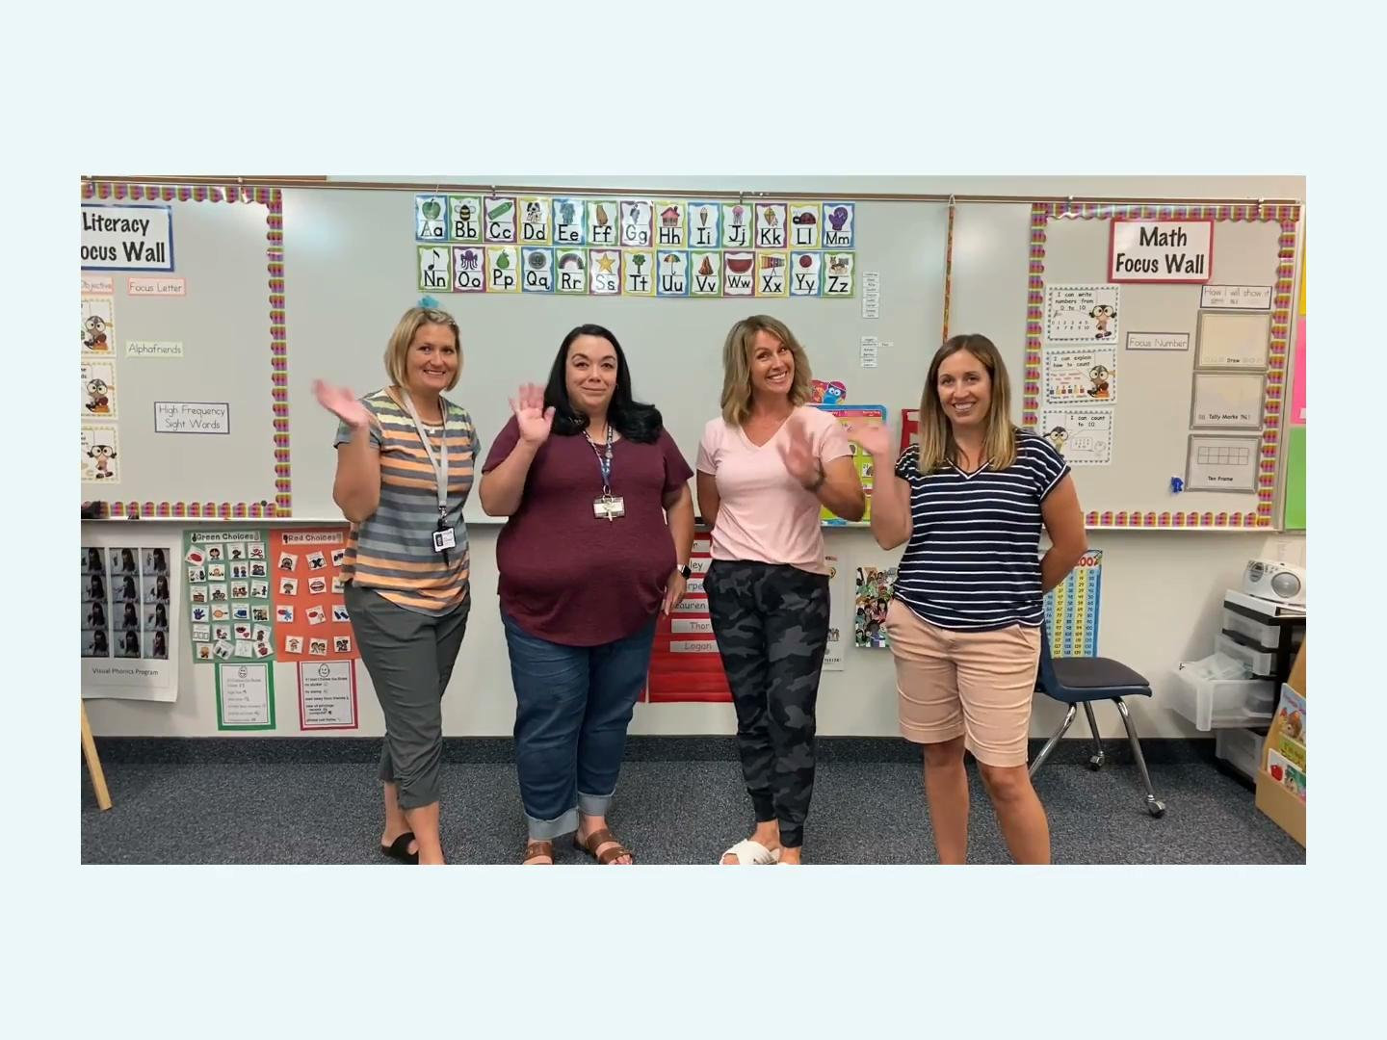
Back

Slide 13
Back

Slide 14
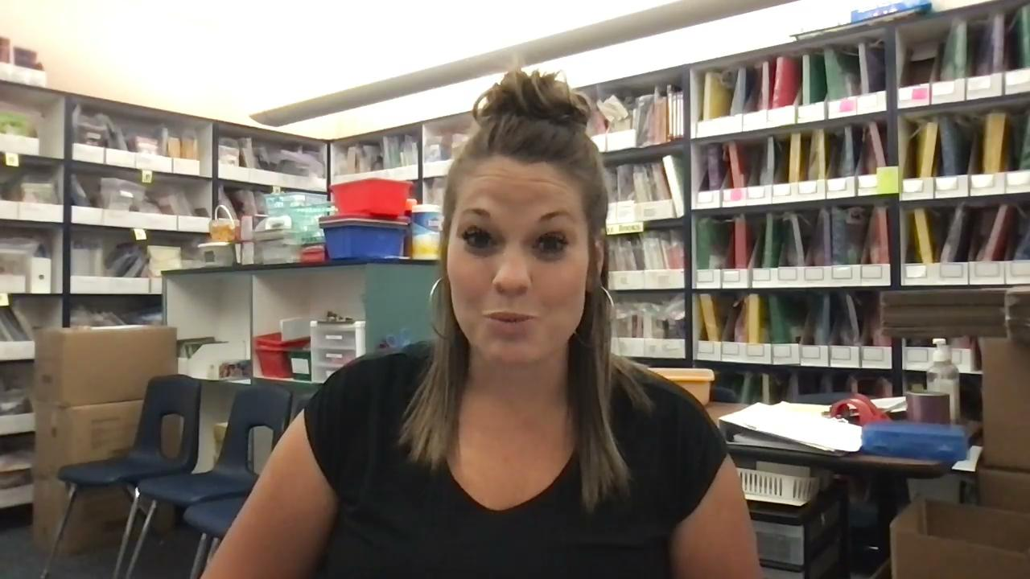
Back

